Slide 1
Shiny App
Group 3: Wanting Cui
Xuying Ding
Hanying JI
Yu Tong
Xiuruo Yan

Slide 2




Slide 3
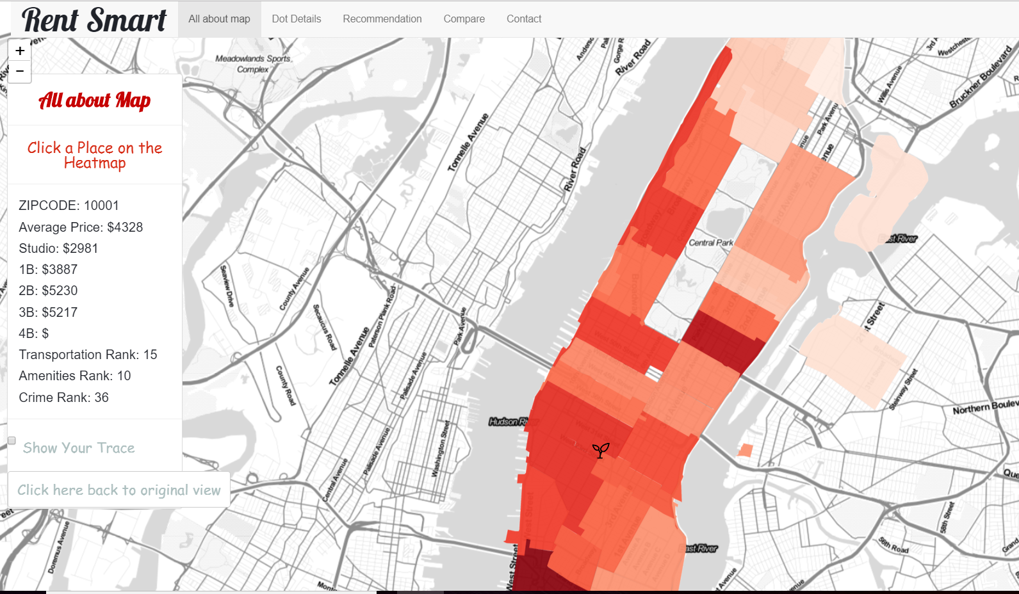
Rent Smart Manhattan

Slide 4
Business Values
People who plan to live in Manhattan
Use this app to find housing
New York real estate agents
Use this app to recommend
Collect data for price setting

